Slide 1
m3: Accurate Flow-Level Performance Estimation using Machine Learning
Chenning Li, Arash Nasr-Esfahany, Kevin Zhao, Kimia Noorbakhsh4 Prateesh Goyal, Mohammad Alizadeh4, Thomas Anderson. MIT CSAIL, University of Washington, Microsoft Research
SIGCOMM 2024
汇报人：张君健

Slide 2
INTRODUCTION
Motive
1. Network simulation is widely used in the design, planning, and operation of networks. However, these proposals still operate at the packet level. As network speeds continue to increase, packet-level models inevitably become too slow.
2. In many use cases, a network designer is interested in certain performance metrics (e.g., network throughput, tail latency, flow completion time) and how they are affected by changes in network conditions and various design choices. Rather than simulate every packet interaction.
Goal
we propose m3: a system that uses machine learning to predict the flow-level performance of a data center network.
performance index : fast, accurate, scalable

Slide 3
INTRODUCTION
Related Work
performance modeling for computer networks into three groups
group | method | accurate | scalable | speed
Queueing Theory | MQL[39, 40] | mean average | easy | -
 | Markovian arrival process[4, 10] | high | hard | slow
Flow-level granularity | Network Calculus[11, 27] | mean average | easy | fast
 | GNN[15, 16, 49] |  | hard | fast
 | Parsimon[55] | high | easy | fast
 | Max-Min Fair Resource[37] | less at short packet | - | fast
Packet-level granularity (ns3) | parallelization accelerate [17, 18] | not needed detail | easy | too slow
 | machine learning accelerate[53, 54]
this paper | m3 | predict p99 fct slowdown | easy | fast

Slide 4
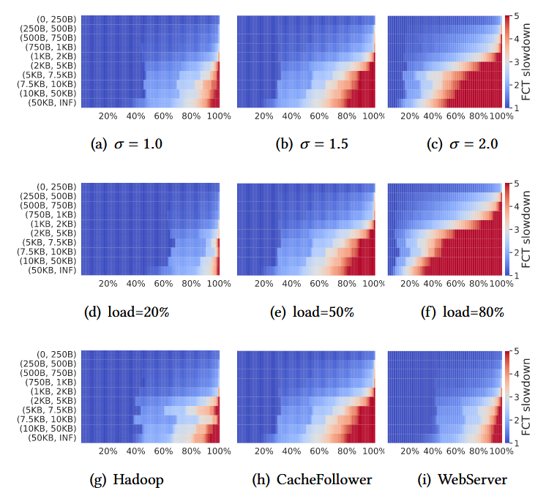
METHOD
validate of FCT slowdown expressive ability
FCT slowdown distributions are a compact representation sensitive to many aspects of the workload, allowing a machine learning model to pick up on the differences between workloads with distinct behavior and produce accurate slowdown estimates.
figure a-c) show impact of traffic burstiness
figure d-f) show impact of increasing load
figure g-i) show impact of workload

Slide 5
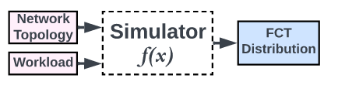
METHOD
proposal
input: network topology and workload data
output: p99(99th-percentile) FCT(flow completion time) slowdown
two challenges
1) larger data set: the space of possible workloads and network topologies is vast.
solution: decomposition and select representative sample
2) represent data effciently: The network topology is an arbitrary graph and the
workload is an arbitrary sequence of flows.
solution: choice expressive features and make it scalable

Slide 6
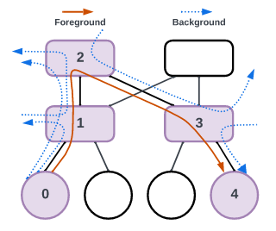
METHOD
method of larger data set solution : path-level decomposition
inspiration
Parsimon[55] Scalable Tail Latency Estimation for Data Center Networks (NSDI 2023)
decomposing one path data into two part
We decompose the network into a set of paths, each path
is a sequence of links and switches connecting a source node
with some destination
one foreground flow: traverse the entire path
several background flow: intersect the path at one or more hops
reduce dataset size
1. reduce flow data number in one path: not all flow is selected
2. reduce path data number: sample probability proportional to the number of foreground flows

Slide 7
METHOD
method of larger data set solution : path-level decomposition
assumption weaker assumption than prior work[55]
the performance of foreground traffic is primarily determined by the latency, capacity, and scheduling policies of the links along the path, along with the characteristics of the foreground and background traffic.
flows that do not intersect a path do not significantly affect the behavior of foreground traffic.
validate assumption
sample 500 paths(1/4 of all) called ns3-path data from 10 million ns3 flows data,only simulate the decomposition flow, compare their p99 FCT slow down result is 2% error.
Scenario | ns3 p99 sldn | ns3-path p99 sldn
1 | 4.565 | 4.527
2 | 4.602 | 4.504
3 | 13.891 | 13.07

Slide 8
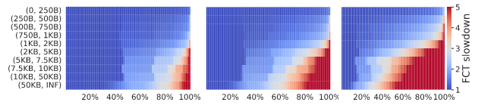
METHOD
method of represent data effciently solution : a fast flow-level simulator
inspiration
[37]Max-Min Fair Resource Allocations Quickly on Large Graphs. (NSDI 2024).
Substitute a fast flow-level simulator(flowSim, very fast) for ns3
build a simulator to extract rich workload-related features suited to FCT performance prediction
Deriving Feature Maps from flowSim’s FCT Slowdown
categorizes foreground flows into s buckets based on the size of each flow.
within each bucket s, m3 records the slowdown (Sldn) predicted by flowSim across p fixed percentiles. The finnal feature map has dimension s * p.

Slide 9
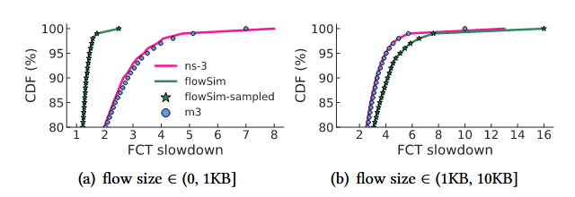
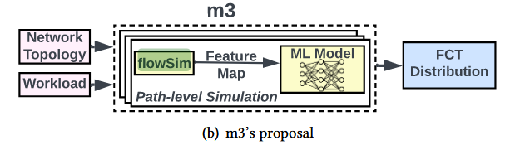
METHOD
method of represent data effciently solution : a fast flow-level simulator
validate effect of FlowSim
good estimates of FCT slowdown for large flows
underestimates the FCTs of short flows
correct error in short flows by machine learning
1) transformer model small Llama-2, to make a fix length context
2) two-layer multilayer perceptron (MLP), trainng to correct error of FlowSim
m3 high-level architecture

Slide 10
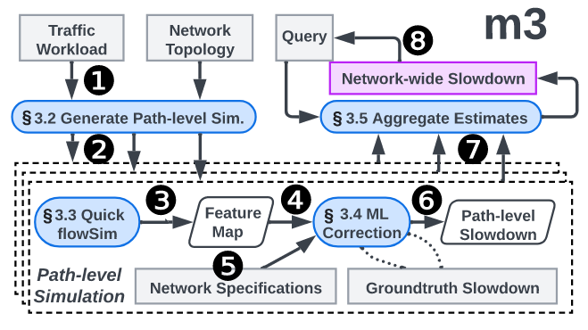
ARCHITECTURE
workflow
1. decomposes path and reduce the their number
2. The sampled path simulations executed in parallel.
3. simulations is flowSim
4. translated into a feature map
5. combined with network specifications
6. machine learning to refine its predictions of FCT slowdowns
7. aggregates result into network-wide performance metrics

Slide 11
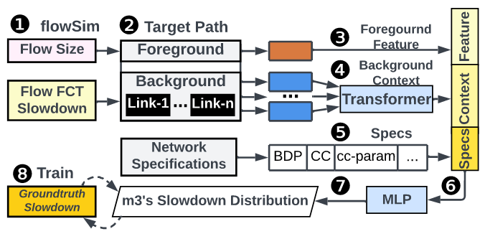
ARCHITECTURE
machine learning model
1. Starting with FlowSim data
2. transforms the FCT slowdowns into structured feature maps
3. The foreground feature map flattened
4. feeds the sequence of background feature maps into a generic sequence model (small Llama-2 [50]) to generate a fixed-length vector
5. input network specification data.
6. The combined all data then fed into a two-layer multilayer perceptron (MLP) model to predict the finnal slowdown distribution of foreground flows for this path
7. generates the foreground FCT slowdown at specific percentiles for designated flow size buckets
8. training with ground truth

Slide 12
EVALUATION
evaluate m3 using three criteria:
1) Generalization across workloads and topologies
2) Scalability for large-scale network topologies
3) Counterfactual search for network parameter exploration
Ablation Study
ablate m3’s design choices to measurement performance of m3
1) use perfect simulator(ns3) replace flowSim
2) remove ML model only using flowSim

Slide 13
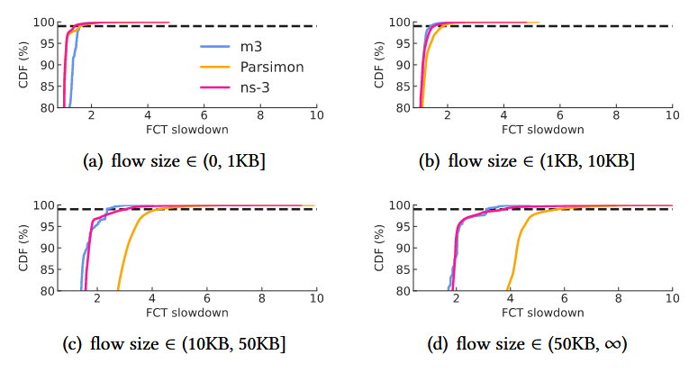
EVALUATION
Scalability for large-scale network topologies

Slide 14
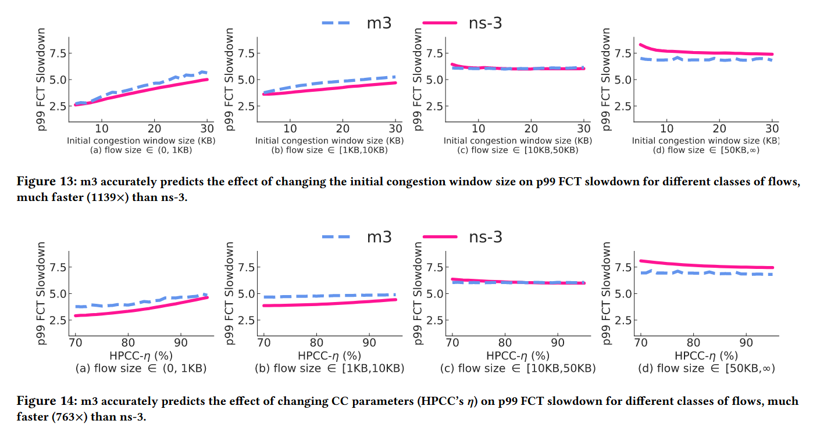
EVALUATION
Counterfactual search for network parameter exploration

Slide 15
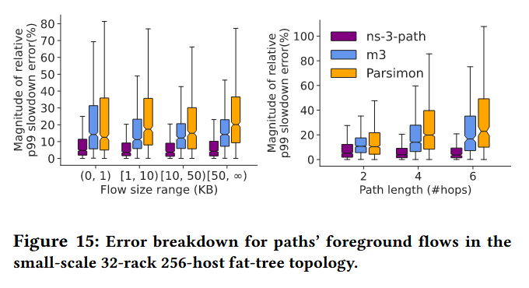
EVALUATION
Ablation Study

Slide 16
THANKS

